Slide 1

ACME’s Data Analysis
Kyriakos Kyriakou

Slide 2
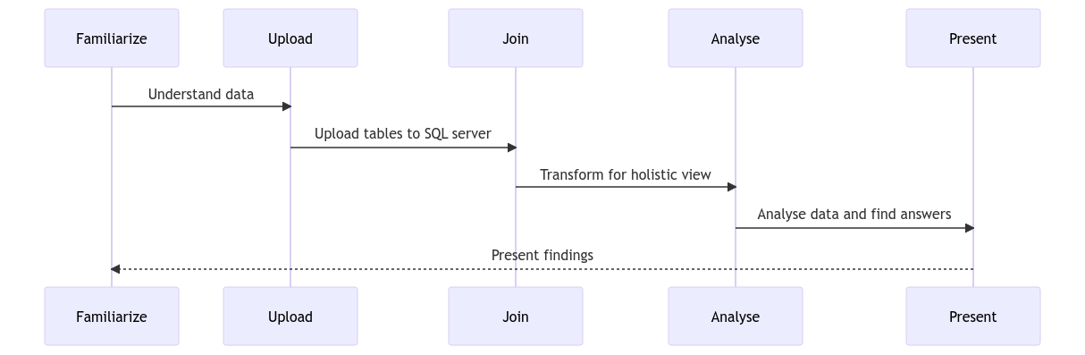
Introduction & Objective
Task: Review – Understand – Analyse ACME’s purchasing data.
Goal: Drive business decisions and identify opportunities for cost savings for ACME.

Slide 3
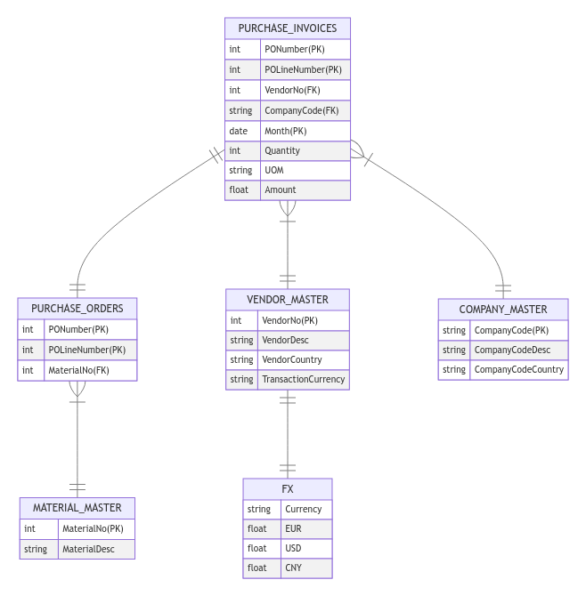
Data Overview
Purchase Invoices: Main table, with references to purchase orders, vendors, and companies.
PONumber links to PONumber of Purchase Orders.
VendorNo links to VendorNo of Vendor Master.
CompanyCode links to CompanyCode of Company master.
Purchase Orders: Contains information about what materials are in each purchase.
PONumber links to PONumber of Purchase invoices.
MaterialNo links to MaterialNo of Material master.
Material Master: Contains information about the materials.
Connected with Purchase orders table by MaterialNo.
Vendor Master: Contains information about each vendor, including the country and the transaction currency.
VendorNo links to VendorNo of Purchase invoices table.
TransactionCurrency links implicitly Currency of FX sheet.
FX: Contains currency rates.
Company Master: Contains information about each company, including the unit country.
Connected with Purchase invoices table by CompanyCode.

Slide 4
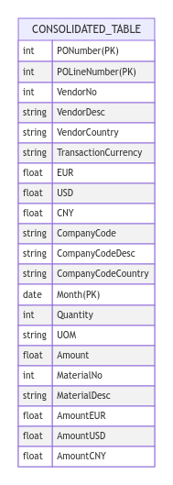

Data Holistic View
Join Conditions: Considering that Purchase_invoices main table.
Join Purchase_invoices with Vendor_master on vendor number to retrieve vendor information.
Join Vendor_master with FX on transaction currency to include exchange rate details.
Join Purchase_invoices with Company_master on company code to obtain company information.
Join Purchase_invoices with Purchase_orders on purchase number & purchase line number to link purchase order data.
Join Purchase_orders with Material_master on material number for material descriptions.
Check duplicates: Checking duplicates based on PONumber POLineNumber, Month.
Common Amount fields: Convert amounts into a USD, EUR, CNY.
Result:
Tried both INNER and LEFT join between the tables → produce identical results.
Consistency of the data with relationships maintained.
Ready for analysis.

Slide 5

Purchasing Analysis Overview
What has been purchased and from whom?
Output DISTINCT Material, Vendors
What is the spend share of the different materials?
Got material spends with GROUP BY Material and the inner query to get total.
Materials | Vendors
Alarm system bulbs 140W | Fabulous IndustriTeknik A/S
Motor IP20 5.5kW | Cheney industrials
Motor IP20 5.5kW | Frankfurter industri GmbH
Motor IP20 5.5kW | HH Metal Kft.
Motor IP20 5.5kW | Metal Bros (AUSTRALIA) PTY LTD
Motor IP20 5.5kW | Metal Bros (London) Ltd
Motor IP20 5.5kW | Metal bros GmbH
Motor IP20 5.5kW | Metal Bros INDUSTRIES PTE
Motor IP20 5.5kW | Metal Bros SARL
Motor IP20 5.5kW | Metal Bros(Shanghai)Automatic Cont. Co
Motor IP20 5.5kW | Steel & all Danmark A/S
Motor IP55 3kW | Steel & all Danmark A/S
Sensor cables 20mt | Italian steel co
Transmission motor X334 0,5mm | INSANE TECH A/S
Materials | Spend (EUR) | Spend Share (%)
Alarm system bulbs 140W | 12152.750218 | 2.08960731426898
Motor IP20 5.5kW | 466476.319869 | 80.2083736147055
Motor IP55 3kW | 21934.346852 | 3.77150610301895
Sensor cables 20mt | 34749 | 5.9749244624467
Transmission motor X334 0,5mm | 46268.157316 | 7.95558850555989
Who are our top 3 vendors based on spend?
Got top 3 vendors by SUM, GROUP BY Vendors, ORDER DESC.
Vendors | Spend (EUR)
Metal Bros(Shanghai)Automatic Cont. Co | 206508.212229
HH Metal Kft. | 74452.4
INSANE TECH A/S | 46268.157316

Slide 6
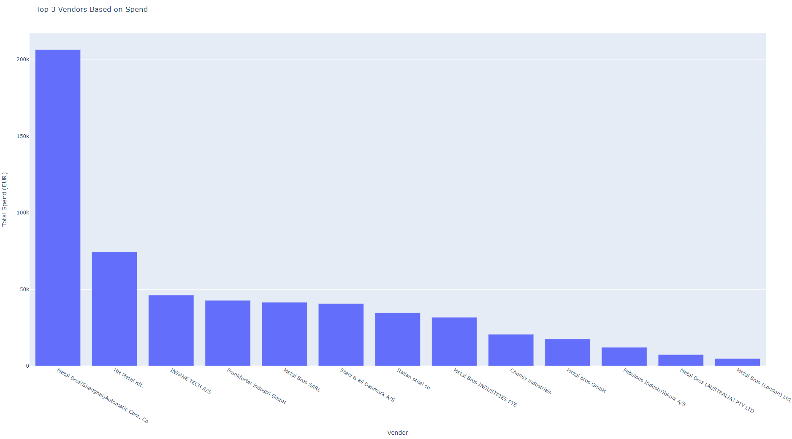
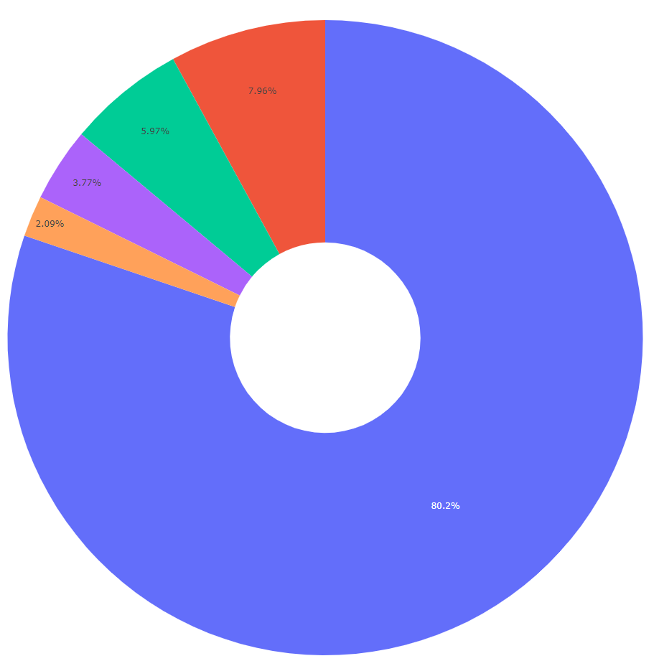
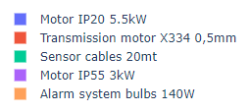
Purchasing Analysis Overview
What is the spend share of the different materials?
Got material spends with GROUP BY and the inner query to get total.
Who are our top 3 vendors based on spend?
Got top 3 vendors by SUM, GROUP BY, ORDER DESC.
Materials | Spend (EUR) | Spend Share (%)
Alarm system bulbs 140W | 12152.750218 | 2.08960731426898
Motor IP20 5.5kW | 466476.319869 | 80.2083736147055
Motor IP55 3kW | 21934.346852 | 3.77150610301895
Sensor cables 20mt | 34749 | 5.9749244624467
Transmission motor X334 0,5mm | 46268.157316 | 7.95558850555989
Vendors | Spend (EUR)
Metal Bros(Shanghai)Automatic Cont. Co | 206508.212229
HH Metal Kft. | 74452.4
INSANE TECH A/S | 46268.157316

Slide 7

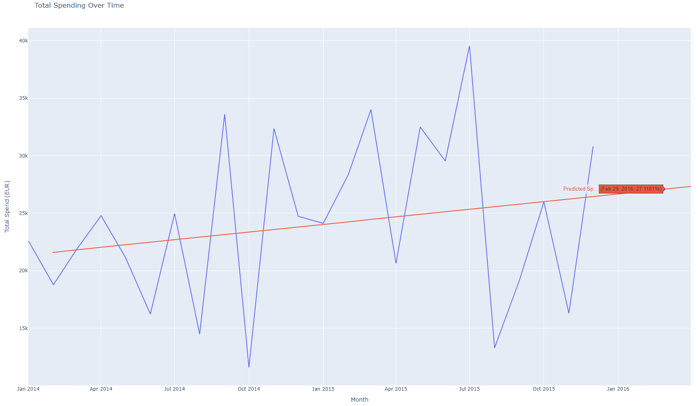
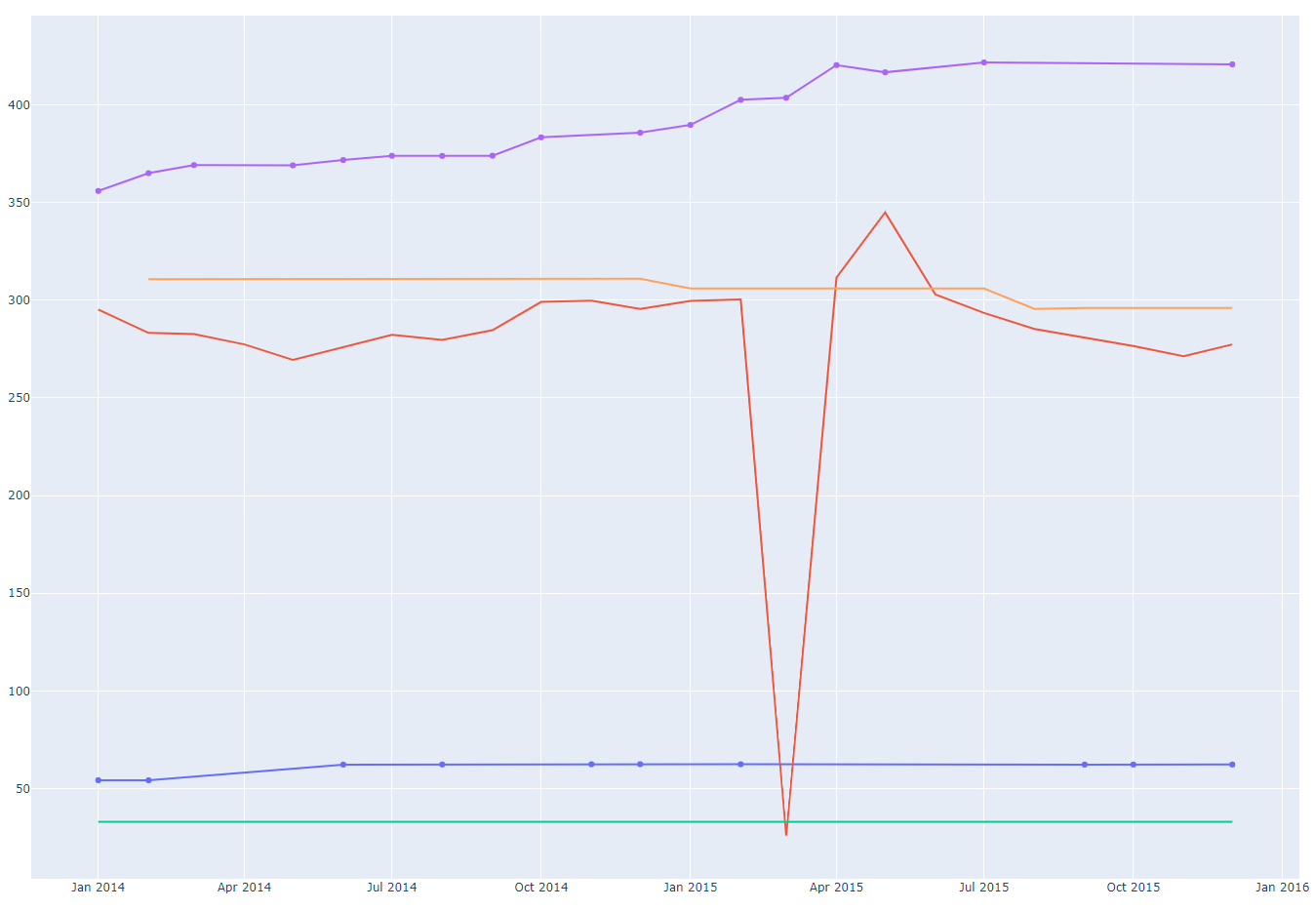

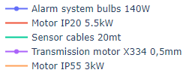

Spending Development Over Time
How does our spending develop over time?
GROUP BY and ORDER BY Month, the SUM of amount in euros.
How is our spending for specific materials?
GROUP BY and ORDER BY Month-Material, the weighted avg. price per unit of each material (SUM(Amount) / SUM(Quantity)).

Slide 8
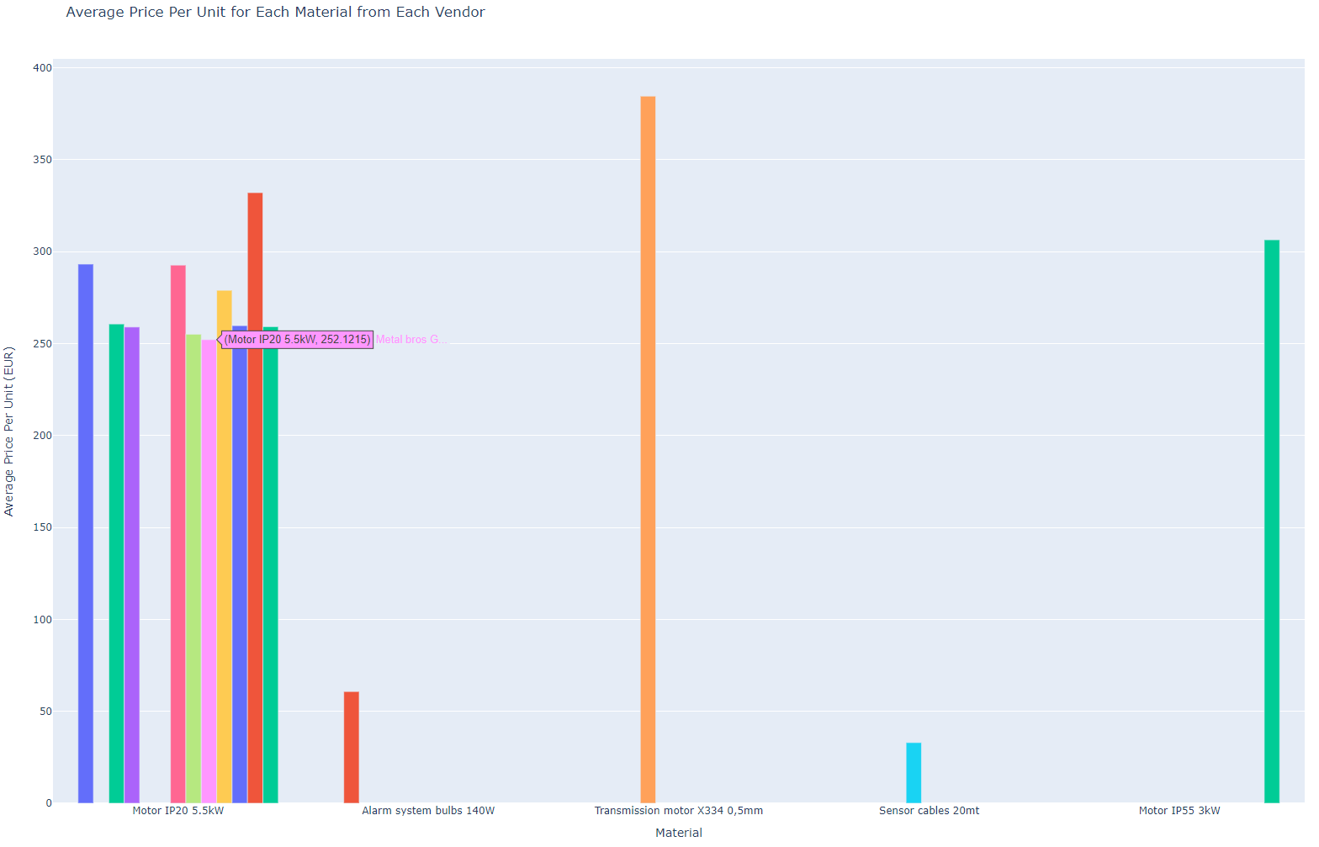
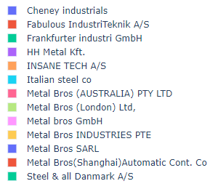
Spending Savings
Where can we save money?
Can we get better price from another vendor or concentrate bigger volumes to some specific vendor?
→ GROUP BY Materials and Vendors, and show the average (AVG(Amount / Quantity)) spend per unit for each material-vendor for each purchase.
Findings:
Materials like "Alarm system bulbs 140W", "Sensor cables 20mt", and "Transmission motor X334 0,5mm“ only supplied by single vendors. (Risk?)
“Motor IP20 5.5kW” purchased by many vendors → Shift to cheapest vendor named: Metal Bros GmbH (252.12 euros) for cost reduction.
Ask for discount from Cheney Industrials & Italian steel co as we buy with big quantity materials (1057, 1053).

Slide 9
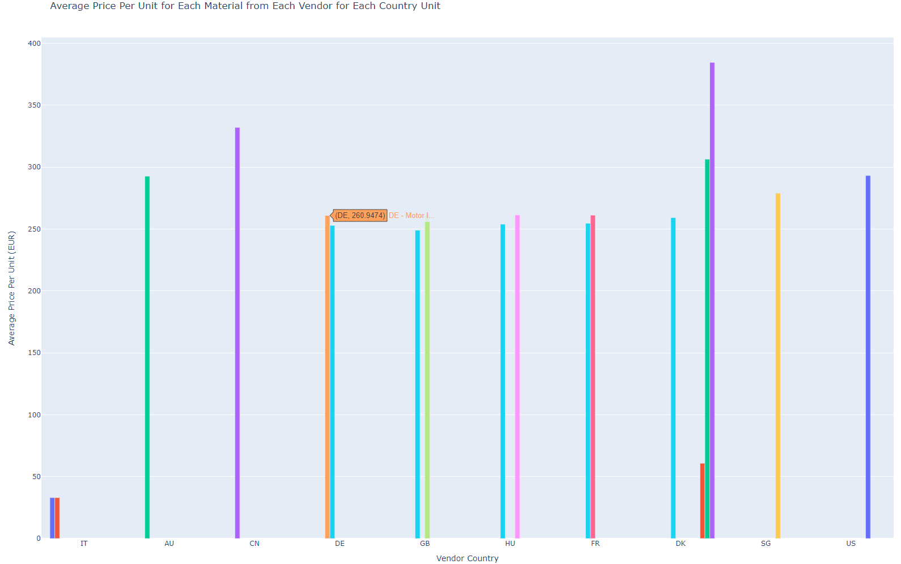
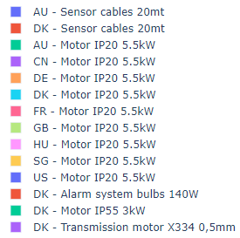
Spending Savings 2
How can we benefit for less cost spending?
Can we optimize our choice of material vendors based on country-specific pricing differences?
→ GROUP BY Materials, Vendor Country, Company Code, and show the average spend per unit for each material-vendor country-unit country.
Findings:
For the material 'Motor IP20 5.5kW,' we could save money in the country units DE, GB, HU, and FR if we procure it through our DK country unit instead of local units.
DK unit supplying from GB vendor is the cheapest (maybe shift to that vendor).
For Material " Motor IP20 5.5kW ", in countries AU, CN, US, SG, maybe consider global vendors (GB?) or other country company units.

Slide 10

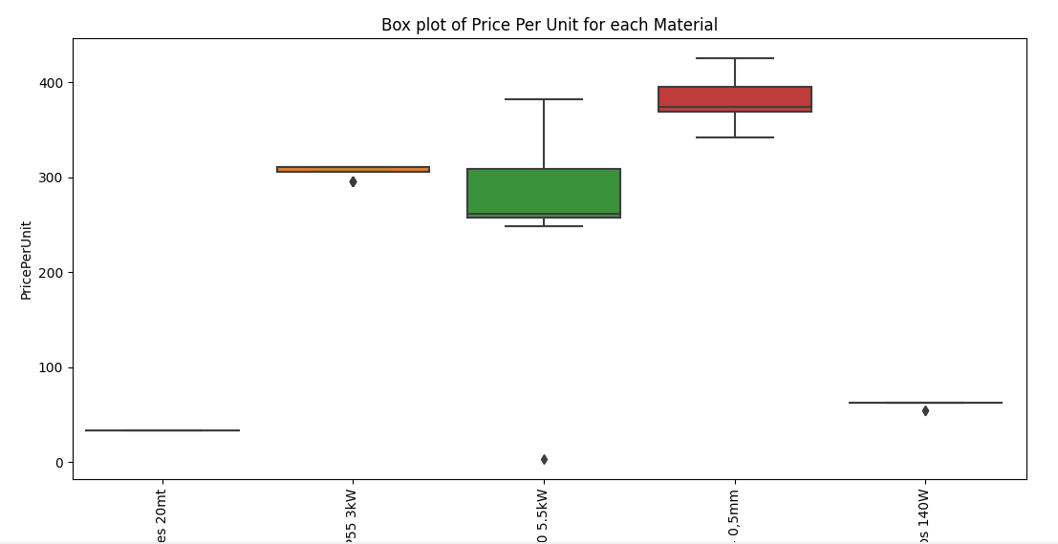
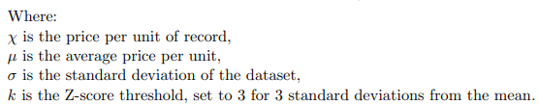
Recording mistakes
Get average(AVG) and standard deviation (STDEV) in price per unit for specific materials to check inconsistency of prices – quantity → Using three-sigma rule.
Record outlier: PO Order: 8120821, with unusual quantity of 1000 (unusually high).
Tried checking for negatives, zero values.
NTILE (Inter Quartile Range IQR)?

Slide 11


Thank you

